Slide 1
IaaS, Paas, Saas
Cloud computing Module 3
Dr Bijoy A Jose

Slide 2
Cloud infrastructure management
Management models:
  Public clouds
    Utility model
    Shared hardware
    No control of hardware,
    Self-managed (e.g., AWS, Azure, GCE)
  Private clouds:
    More isolated (secure?),
    Federal compliance friendly
    Customizable hardware and hardware sharing
    Example: OpenStack, an open source platform for virtualized clouds

Slide 3
Cloud Computing-What is it?
Moving services, computation and to an internal or external, centralized facility or contractor.
Reason
  easy and ubiquitous accessibility
  cost
  collaboration, integration, and analysis on a shared common platform.

Slide 4




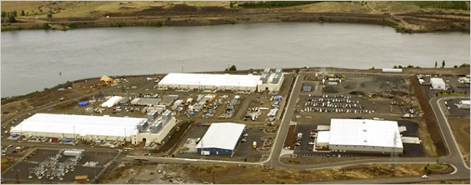
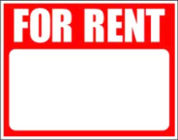
What is it?
SLAs
Web Services
Virtualization

Slide 5
Virtualization: key to cloud boom
Physical machine virtualization
  Full virtualization: masking as physical machine to guest
  Para-virtualization: Semi-transparent to guest
Virtualization goes well beyond CPU or physical machines
  Virtualized I/O (Elastic Block Storage)
  Virtual private networks
  Containers (e.g., AWS or Google Container Service)
  Virtual switches/routers with software-defined networking (SDN)
  Network function virtualization (NFV) forwarding-plane services

Slide 6













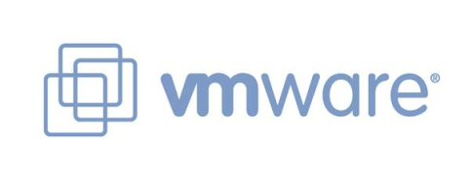




Commercial Cloud Formation

Slide 7
Common cloud computing models
Service models:
  IaaS: Infrastructure as a Service
    Providing computational and storage infrastructure in a centralized, location-transparent service
    e.g., Amazon EC2, Microsoft Azure, Google Compute Engine
  PaaS: Platform as a Service
    Foundational elements to develop new applications
    e.g., Google AppEngine, Heroku, Apache Stratos
  SaaS: Software as a Service
    WAN-enabled application services
    Microsoft Office365, Amazon DynamoDB, gmail

Slide 8
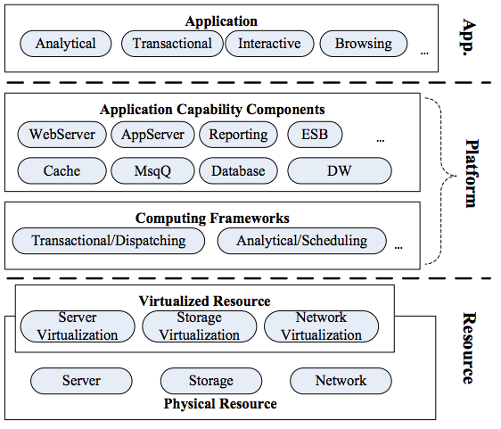
Core Stacks
Source: Goel, Pragati, and Mayank Kumar. "An overview of Cloud Computing."

Slide 9
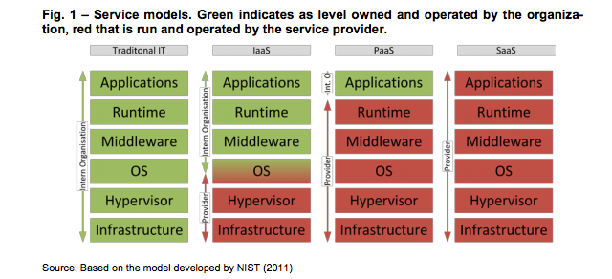
What is it?
Green indicates the levels owned and operated by the organization
Red levels are run and operated by the service provider

Slide 10
Goals of PaaS
The ultimate goal of a PaaS is to make it easier for you to run your website or web application no matter how much traffic it gets.
You just deploy your application and the service figures out what to do with it.
A platform as a service should handle scaling seamlessly for you so you can just focus on your website and the code running it.

Slide 11
Why PaaS?
There is always a conflict between the developers and the System Engineers
Developers are keen on getting their environments up without waiting.
System Engineers care about performance and stability
Creates a peaceful environment for both parties

Slide 12
SaaS Definition
Software as Service is a software delivery model in which software and data are hosted centrally and accessed via web. It can be rented .
Configuration and customization
according to the customer
Accelerated feature delivery
weekly updates
Multi tenant architecture
single instance of the software for multiple client organizations
Open integration protocols
API’S and protocols for accessing company’s internal systems

Slide 13
ADVANTAGES
USER BENEFITS:
Lower Cost of Ownership
Focus on Core Competency .
Access Anywhere
Freedom to Choose (or Better Software)
Faster Product Cycles
VENDOR BENEFITS:
.Increased Total Available Market
. Lower Development Costs & Quicker Time-to-Market
. Improved Customer Relationships

Slide 14














Perspectives
Utility Computing
Platform as a Service (PaaS)
Cloud-based User Applications

Slide 15
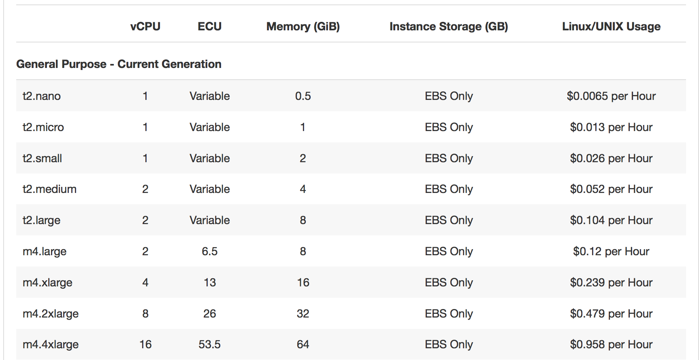
EC2 compute pricing
Do these numbers match our intuition based on market prices for computers and peripherals?

Slide 16
Important factors for a good design
Three key differentiators that separate well-designed SaaS application from a poorly designed one
  scalability
  Multi tenant efficient
  configurable
Scaling the application - maximizing concurrency, and efficient use of resources
  i.e. optimizing locking duration, statelessness, sharing pooled resources such as threads and network connections, caching reference data, and partitioning large databases

Slide 17
Multi-tenancy – important architectural shift from designing isolated, single-tenant applications
  One application instance should accommodate users from multiple other companies at the same time while providing transparency
  This requires an architecture that maximizes the sharing of resources efficiently across tenants
Configurable - a single application instance on a single server has to accommodate users from several different companies
  Customizing the application for one customer will change the application for other customers as well.
Traditionally customizing an application would mean changes in the code.
Each customer must use metadata to configure the way the application appears and behaves for its users.
Customers configuring applications must be simple and easy without any extra development or operation costs

